Slide 1
CPSC3300: Computer Systems Organization
Lecture 6 – Adders

Slide 2
Outline
Mux
Half adder
Full adder
Carry lookahead adder
Reading
8.5-6

Slide 3
Multiplexers
A n-1 multiplexer, or MUX, for short, is a device that allows you to pick one of n inputs and direct it to an output
Examples:
TV: you select one of many channels to be displayed on your screen
Radio:
An n-1 MUX consists of the following:
Data inputs: n
Control inputs: ceil( log₂ n ) (– what is this?)
Output: 1
Diagram of 2-1 MUX
Data inputs: n=2 (y0, x0)
Control inputs: ceil( log₂ 2 )=1;C: 1 bit
Outputs: 1
y0
x0
y0
x0
2-1MUX
C
C
Z
Z

Slide 4
2-1 MUX cont’d
x1
x0
Behavior of 2-1 MUX
If c==0, then x₀ is directed to the output z
If c==1, then x₁ is directed to the output z
Truth table
Boolean Expression:
Implement it with logic gates by yourself
1
2-1MUX
0
Row | C | X1 | X0 | Z
0 | 0 | 0 | 0 | 0
1 | 0 | 0 | 1 | 1
2 | 0 | 1 | 0 | 0
3 | 0 | 1 | 1 | 1
4 | 1 | 0 | 0 | 0
5 | 1 | 0 | 1 | 0
6 | 1 | 1 | 0 | 1
7 | 1 | 1 | 1 | 1
Row | C | Z
0 | 0 | X0
1 | 1 | X1
Z
Using 2-1 MUXes, can you build a 4-1 MUX?
Using logic gates, can you build a 1-2 deMUX?

Slide 5
Binary Addition
(0)₁₀ = ( )₂
(1)₁₀ = ( )₂
(2)₁₀ = ( )₂
(3)₁₀ = ( )₂
(4)₁₀ = ( )₂
(5)₁₀ = ( )₂
(6)₁₀ = ( )₂
(7)₁₀ = ( )₂
(8)₁₀ = ( )₂
Let's consider adding two 3-bit UB (unsigned binary) numbers.
1 1 0
+ 0 1 1
-----------

Slide 6
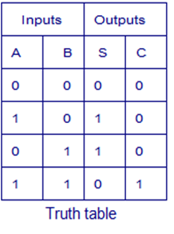
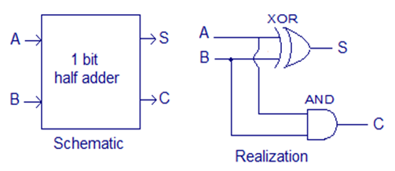
Machine Addition
Consider adding two bits (binary digits) together:
A + B = ?
0 + 0 = 0
0 + 1 = 1
1 + 0 = 1
1 + 1 = 10
S is for “SUM”
C is for “CARRY”
C = AND(A, B)
S = XOR(A, B)
Half Adder
add two 1-digit addends, can only be
used to add the least significant bit (can’t deal
with a carry-in bit from the lower digit)

Slide 7
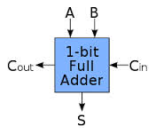
Full Adder
A half Adders does not handle carries
A full adder can handle three bits
– 3 data inputs: X, Y, and C_{in}
– 2 outputs: S for sum and C_{out} for carry out
Truth table?
Boolean expression?
Circuits?
A | B | C_{in}
0 | 0 | 0
0 | 0 | 1
0 | 1 | 0
0 | 1 | 1
1 | 0 | 0
1 | 0 | 1
1 | 1 | 0
1 | 1 | 1
C_{out} | S
0 | 0
0 | 1
0 | 1
1 | 0
0 | 1
1 | 0
1 | 0
1 | 1
C_{out} | S

Slide 8
Boolean Function
Determine logic function for full adder from truth table
C =
S =
Add details of circuits

Slide 9
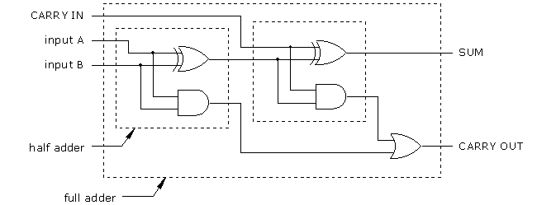
Full Adder Implementation
Write out the logic functions for full adder
Cout =
S =
Add details of circuits
Build full adder with half adders and basic logic gates
Abstraction
A Full Adder

Slide 10
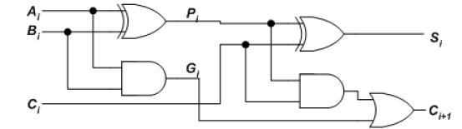

Lookahead Adder
i
Two internal signals
Carry propagate: if P_{i}=1 (G_{i}=0), C_{i+1}=C_{i}
Carry generate: if G=1, C_{i+1}=1
Depending on A and B only
Delay of computed values of all the P_{i}’s
One XOR-gate delay after operands A and B are made valid
Delay of computed values of all the G_{i}’s
One AND-gate delay after operands A and B are made valid

Slide 11


Sum and Carry Based on P & G
Unroll for bit 0 to bit 4
Values to be calculated: S_{i}, C_{i}
Use P_{i} and G_{i}, which can be calculated with one unit of delay with A_{i}, B_{i}, C₀

Slide 12
4-bit Carry-Lookahead Adder (1)
c₄ = g₃ + g₂ p₃ + g₁ p₂p₃ + g₀p₁p₂p₃ + c₀p₀p₁p₂p₃
c₃ = g₂ + g₁ p₂ + g₀ p₁p₂ + c₀p₀p₁p₂
c₂ = g₁ + g₀ p₁ + c₀p₀p₁
c₁ = g₀ + c₀ p₀
s₀ = a₀ ⊕ b₀ ⊕ c₀ = p₀ ⊕ c₀
s₁ = p₁ ⊕ c₁
s₂ = p₂ ⊕ c₂
s₃ = p₃ ⊕ c₃

Slide 13
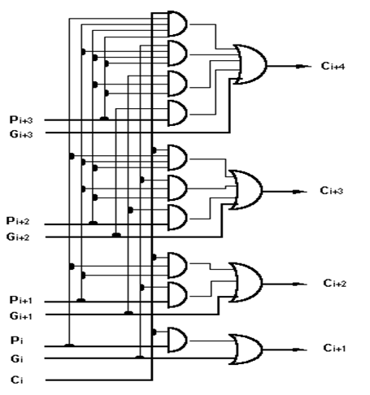
Carry Out Bit in CLA

Slide 14
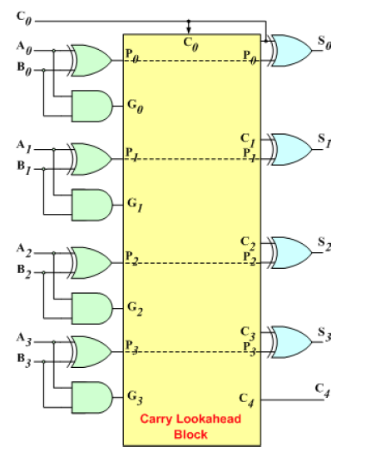
CLA Adder Implementation

Slide 15
Three levels of Logic in CLA
1st level
Generate all the P & G signals with XOR gates and AND gates
P & G valid after 1 unit of time (one gate)
2nd level
2-level implementation logic circuit
First: AND gate
Second: OR gate
Signals C be valid after 2 + 1 units of time
3rd level
XOR gates generate signal S
Signal S be valid after 1 + 2 + 1 units of time
How many time units does a 4-bit ripple adder take?

Slide 16
Summary
Mux and deMux
Half adder
Full adder
Carry look ahead adder
Next lecture reading
5th ed: 8.7-8

